Slide 1
Taking control
Learning objectives
By the end of this lecture you should be able to:
    explain the difference between sequence, selection and iteration;
    use if statements, if...else statements and switch statements to make choices in a program;
    repeat a section of code with a for loop, a while loop, and do...while loop;
    select the most appropriate construct for selection and iteration in a particular program;
    explain the term input validation and write simple validation routines.

Slide 2
  Selection
Programs often need to make choices.
for example
a program processing requests for airline tickets could have the following choices to make:
  display the price of the seats requested;
  display a list of alternative flights;
  display a message saying that no flights are available to that destination.
Selection allows such choices to be made in programs.

Slide 3
Selection: a simple example
Consider the following code fragment
Scanner scan = new Scanner(System.in);
System.out.println("How old are you?");
age = scan.nextInt();
System.out.println("Hello Junior!");
System.out.println("Enjoy your ride");

Slide 4
Two program interactions
How old are you?
10
Hello Junior!
Enjoy your ride
How old are you?
45
Hello Junior!
Enjoy your ride
first program
interaction
second program
interaction

Slide 5
  A first attempt at fixing the problem
Scanner scan = new Scanner(System.in);
System.out.println("How old are you?");
age = scan.nextInt();
IF age is that of a child
BEGIN
System.out.println("Hello Junior!");
END
System.out.println("Enjoy your ride");

Slide 6
  Implementing this selection in Java
This form of selection in Java involves the use of a boolean condition.
if ( /* boolean condition goes here */ )
{
// conditional instruction(s) go here
}

Slide 7
  Putting it all together
Assuming a child is someone less than 13 years of age, we can re-write the initial set of instructions as follows:
Scanner scan = new Scanner(System.in);
System.out.println("How old are you?");
age = scan.nextInt();
if (age < 13)
{
System.out.print("Hello Junior!");
}
System.out.println("Enjoy your ride");

Slide 8
  Interacting with the new code
How old are you?
10
Hello Junior!
Enjoy your ride
How old are you?
45
Enjoy your ride
firstly a child
approaches
the second time
an adult
approaches

Slide 9
The 'if…else' statement
The if…else statement can be used to state two alternative courses of action.
if ( /* test goes here */ )
{
//instruction(s) if test is true
}
else
{
//instruction(s) if test is false
}

Slide 10
‘if...then...else’: an example
int mark;
Scanner scan = new Scanner(System.in);
System.out.println("What exam mark did you get?");
mark = scan.nextInt();
if (mark > 39)
{
System.out.println("Congratulations, you passed");
}
else
{
System.out.println("I'm sorry, but you failed");
}
System.out.println("Good luck with your other exams");

Slide 11
Two sample program interactions
What exam mark did you get?
52
Congratulations, you passed
Good luck with your other exams
first test run when
‘if’ branch is true
What exam mark did you get?
35
I'm sorry, but you failed
Good luck with your other exams
second test run when
‘else’ branch is true

Slide 12
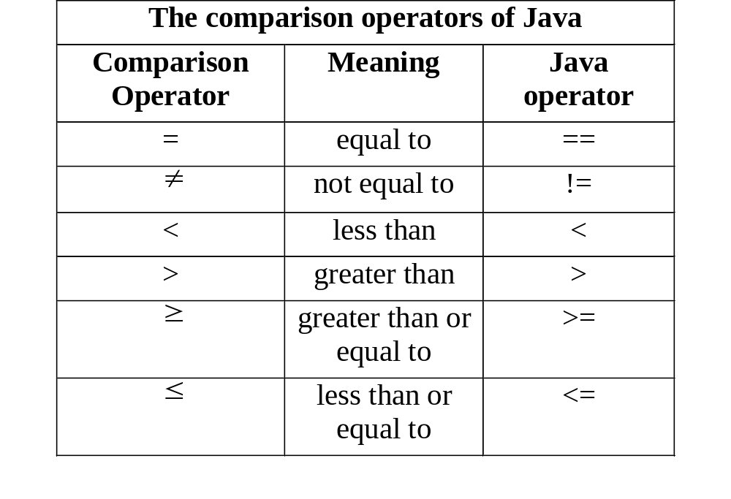

Slide 13
Comparison operators: an example
The following code checks whether or not an angle is a right angle:
if (angle == 90)
{
System.out.println("This is a right angle");
}

Slide 14
The ‘switch’ statement
A switch statement may be used when
only one variable is being checked in each condition
the check involves specific values of that variable
(e.g. 'A', 'B') and not ranges (e.g. >39 ) ;

Slide 15
The ‘switch’statement: an example
int group;
Scanner scan = new Scanner(System.in);
System.out.println("Enter your group (1,2,3)");
group = scan.nextInt():
switch(group)
{
case 1: System.out.print("10.00 a.m ");
break;
case 2: System.out.print("1.00 p.m ");
break;
case 3: System.out.print("11.00 a.m ");
break;
default: System.out.print("No such group");
}

Slide 16
  Iteration
Iteration allows a section of code to be repeated over and over again.
The programming structure that is used to control this repetition is often called a loop.
There are three types of loops in Java:
    for loop;
    while loop;
    do…while loop.

Slide 17
    Printing a square of stars
Consider a program that needs to display a square of stars (five by five) on the screen as follows:
* * * * *
* * * * *
* * * * *
* * * * *
* * * * *

Slide 18
Implementing the program using sequence
System.out.println("*****");
System.out.println("*****");
System.out.println("*****");
System.out.println("*****");
System.out.println("*****");

Slide 19
  Using a loop
Writing out the same line many times is wasteful.
Better to write out the line once and get the program to repeat that same line five times.
For this fixed type of repetition we would normally use Java's for loop

Slide 20
  The ‘for’ loop
set a counter to
some initial value
(usually zero or one)
condition under
which the loop
may continue
changes the counter
value each time
round the loop
for(/*start condition*/;/*while condition*/;/*action*/)
{
// instruction(s) to be repeated go here
}

Slide 21
The ‘for’ loop: an example
for(i = 1; i <= 5; i = i+1)
{
System.out.println("*****");
}

Slide 22
  increment and decrement operators
The action associated with the last for loop is a very common one: add one to the loop counter.
It is so common that a short hand exists for this expression in Java:
i++;
The operator ++ is known as the increment operator of Java.
Similarly there exists a decrement operator (--)
i--;

Slide 23
Program 3.6
class Countdown
{
public static void main(String[] args)
{
int i;
System.out.println("***Numbers from 10 to 1***");
for (i=10; i>=1; i--)
{
System.out.println(i);
}
}
}

Slide 24
    The 'while' loop
The for loop is an often used construct to implement fixed repetitions.
The while loop offers one type of non-fixed iteration.
while ( /* test goes here */ )
{
// instruction(s) to be repeated go here
}

Slide 25
Input validation using a 'while' loop
Checking input data for errors is referred to as input validation. For example:
System.out.println("What exam mark did you get?");
mark = scan.nextInt();
while (mark > 100) // input validation loop
{
System.out.println("invalid mark: Re-enter!");
mark = scan.nextInt();
}
if (mark > 39)
// rest of code goes here

Slide 26
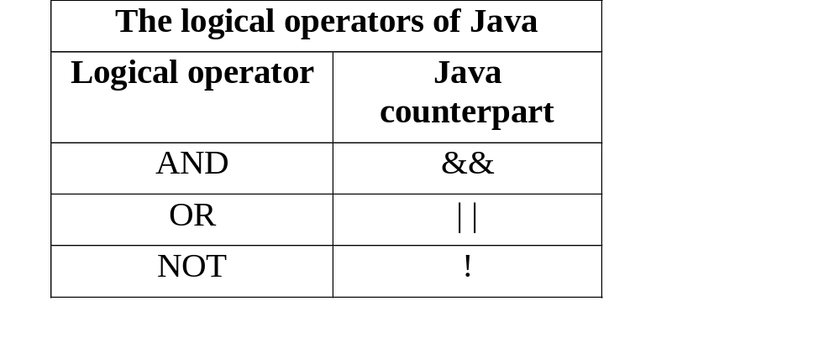
Using logical operators
while (mark < 0 || mark > 100)
{
// instruction(s) to be repeated go here
}

Slide 27
    The ‘do…while’ loop
The do…while loop has its while condition at the end of the loop rather than at the beginning.
If the while condition is at the end of the loop, the loop will iterate at least once. This type of loop is used for menus.
do
{
// instruction(s) to be repeated go here
}while ( /* test goes here */ );

Slide 28
The ‘do...while’ loop: an example
char response;
do
{
// program instructions go here
System.out.println("another go (y/n)?");
response = EasyIn.getChar();
} while (response == 'y');

Slide 29
An example of a menu driven program
int response;
Scanner scan = new Scanner(System.in);
System.out.println("***Lab Times***");
do
{
System.out.println();
System.out.println("[1] TIME FOR GROUP A");
System.out.println("[2] TIME FOR GROUP B");
System.out.println("[3] TIME FOR GROUP C");
System.out.println("[4] QUIT PROGRAM");
System.out.print("enter choice [1,2,3,4]: ");
response = scan.nextInt();
System.out.println();
switch(response)
{
case 1: System.out.println("10.00 a.m ");break;
case 2: System.out.println("1.00 p.m ");break;
case 3: System.out.println("11.00 a.m ");break;
case 4: System.out.println("Goodbye ");break;
default: System.out.println("Options 1-4 only!");
}
} while (response != '4');

Slide 30
Interacting with a menu driven program
[1] TIME FOR GROUP A
[2] TIME FOR GROUP B
[3] TIME FOR GROUP C
[4] QUIT PROGRAM
enter choice [1,2,3,4]: 5
Options 1-4 only!
[1] TIME FOR GROUP A
[2] TIME FOR GROUP B
[3] TIME FOR GROUP C
[4] QUIT PROGRAM
enter choice [1,2,3,4]: 1
10.00 a.m
[1] TIME FOR GROUP A
[2] TIME FOR GROUP B
[3] TIME FOR GROUP C
[4] QUIT PROGRAM
enter choice [1,2,3,4]: 4
Goodbye

